Slide 1
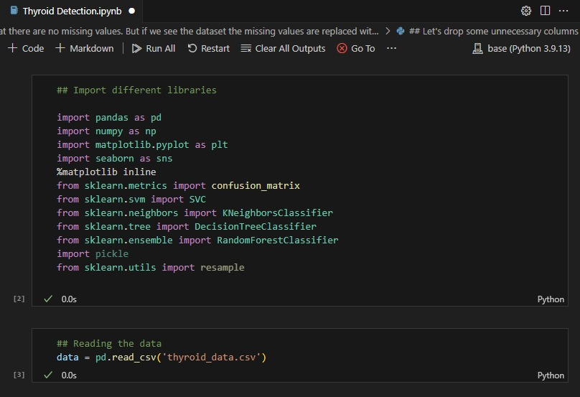
snapshot

Slide 2
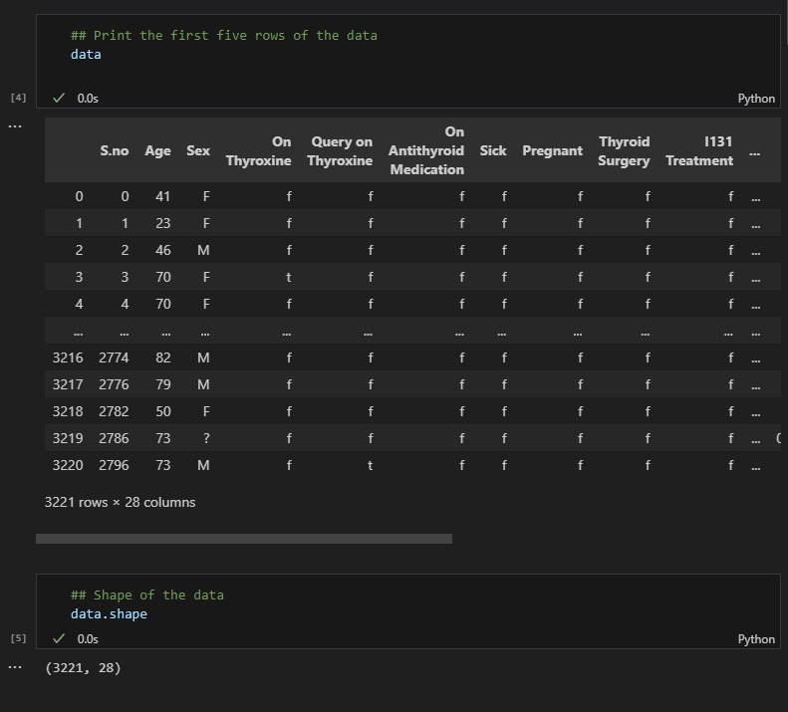

Slide 3
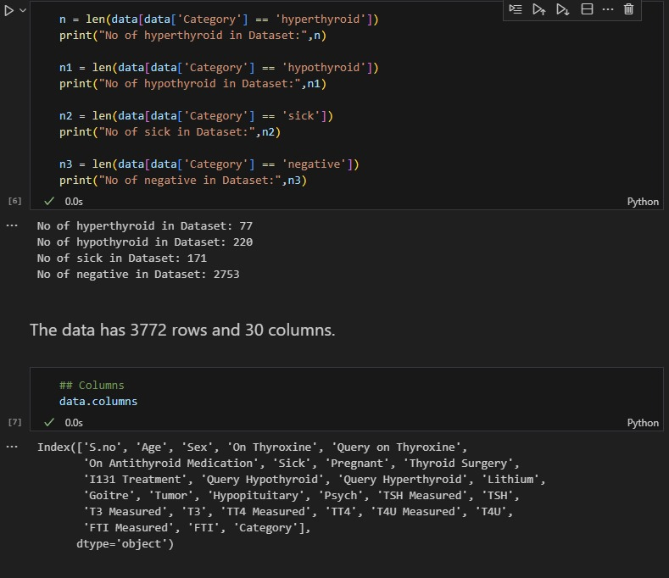

Slide 4
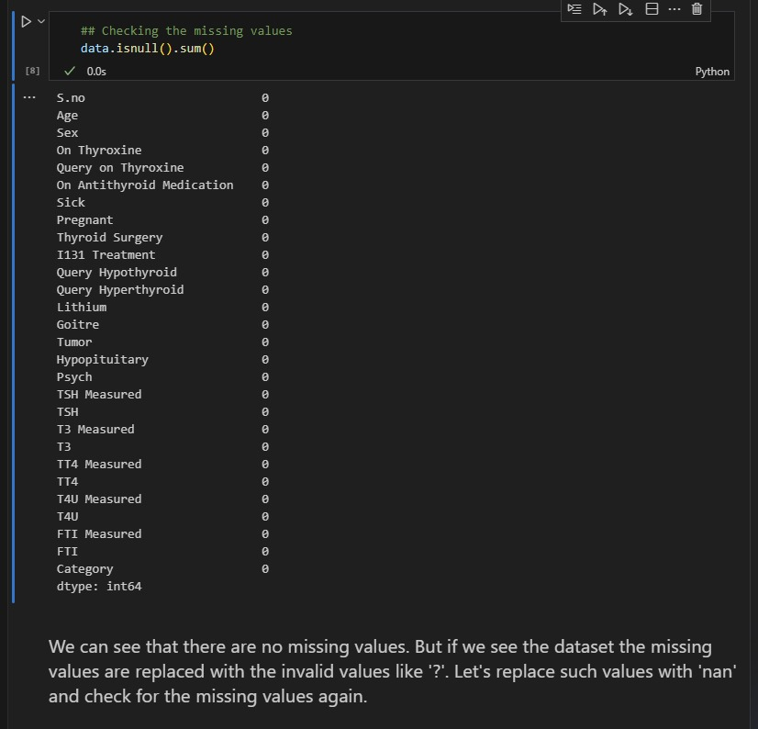

Slide 5
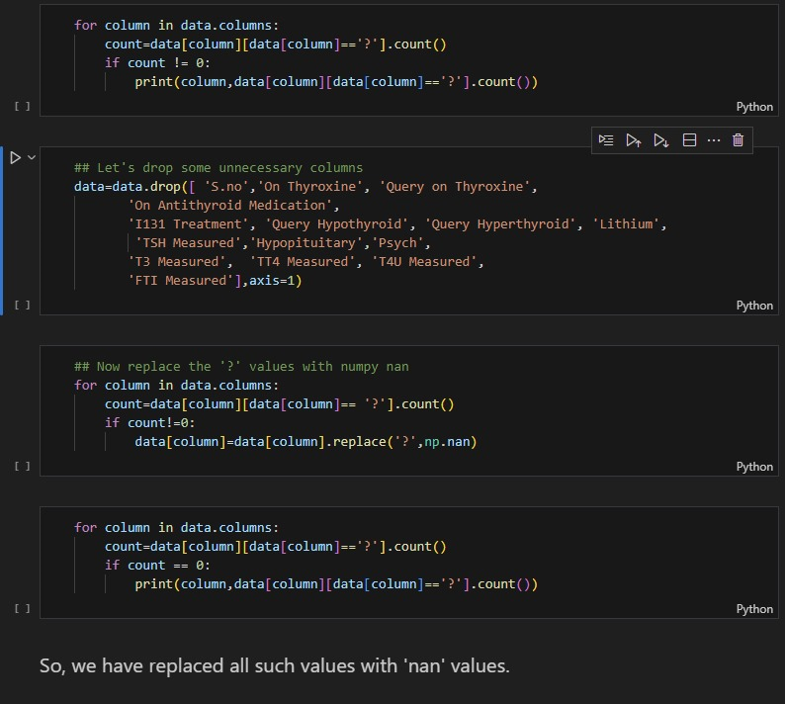

Slide 6
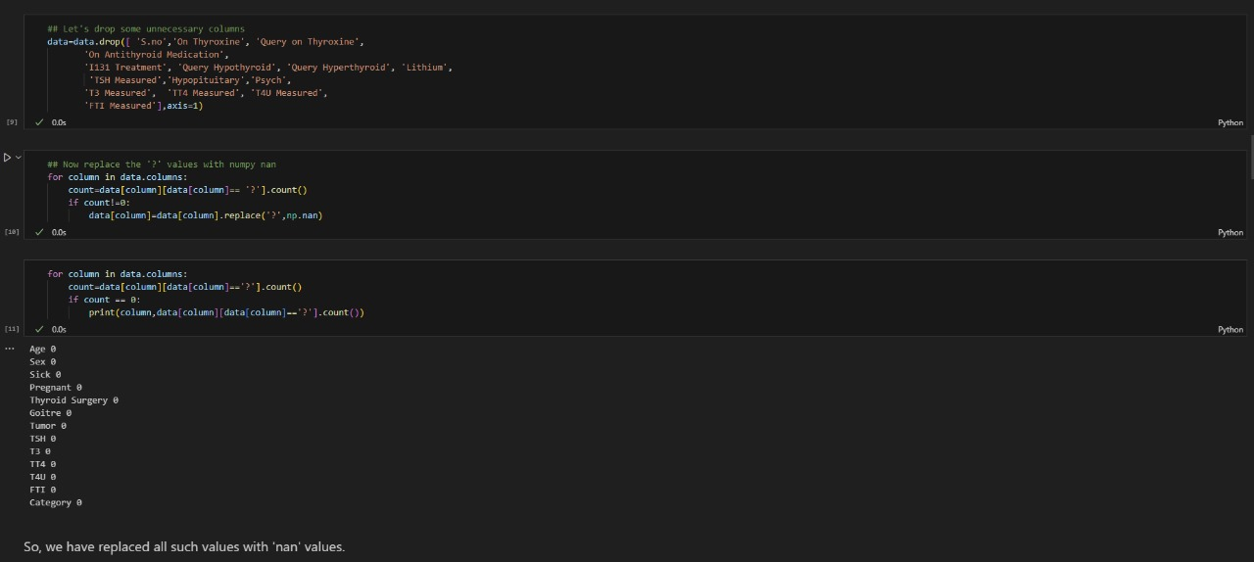

Slide 7
Software Requirements
Hardware Requirement
PROCESSOR: 64-bit
ROM : 2GB
RAM : 4GB
Software Requirements
OPERATING SYSTEM: WINDOWS 8/10
FRONT END : HTML
BACK END : PYTHON, FLASK, STREAMLIT/HEROKU

